Slide 1
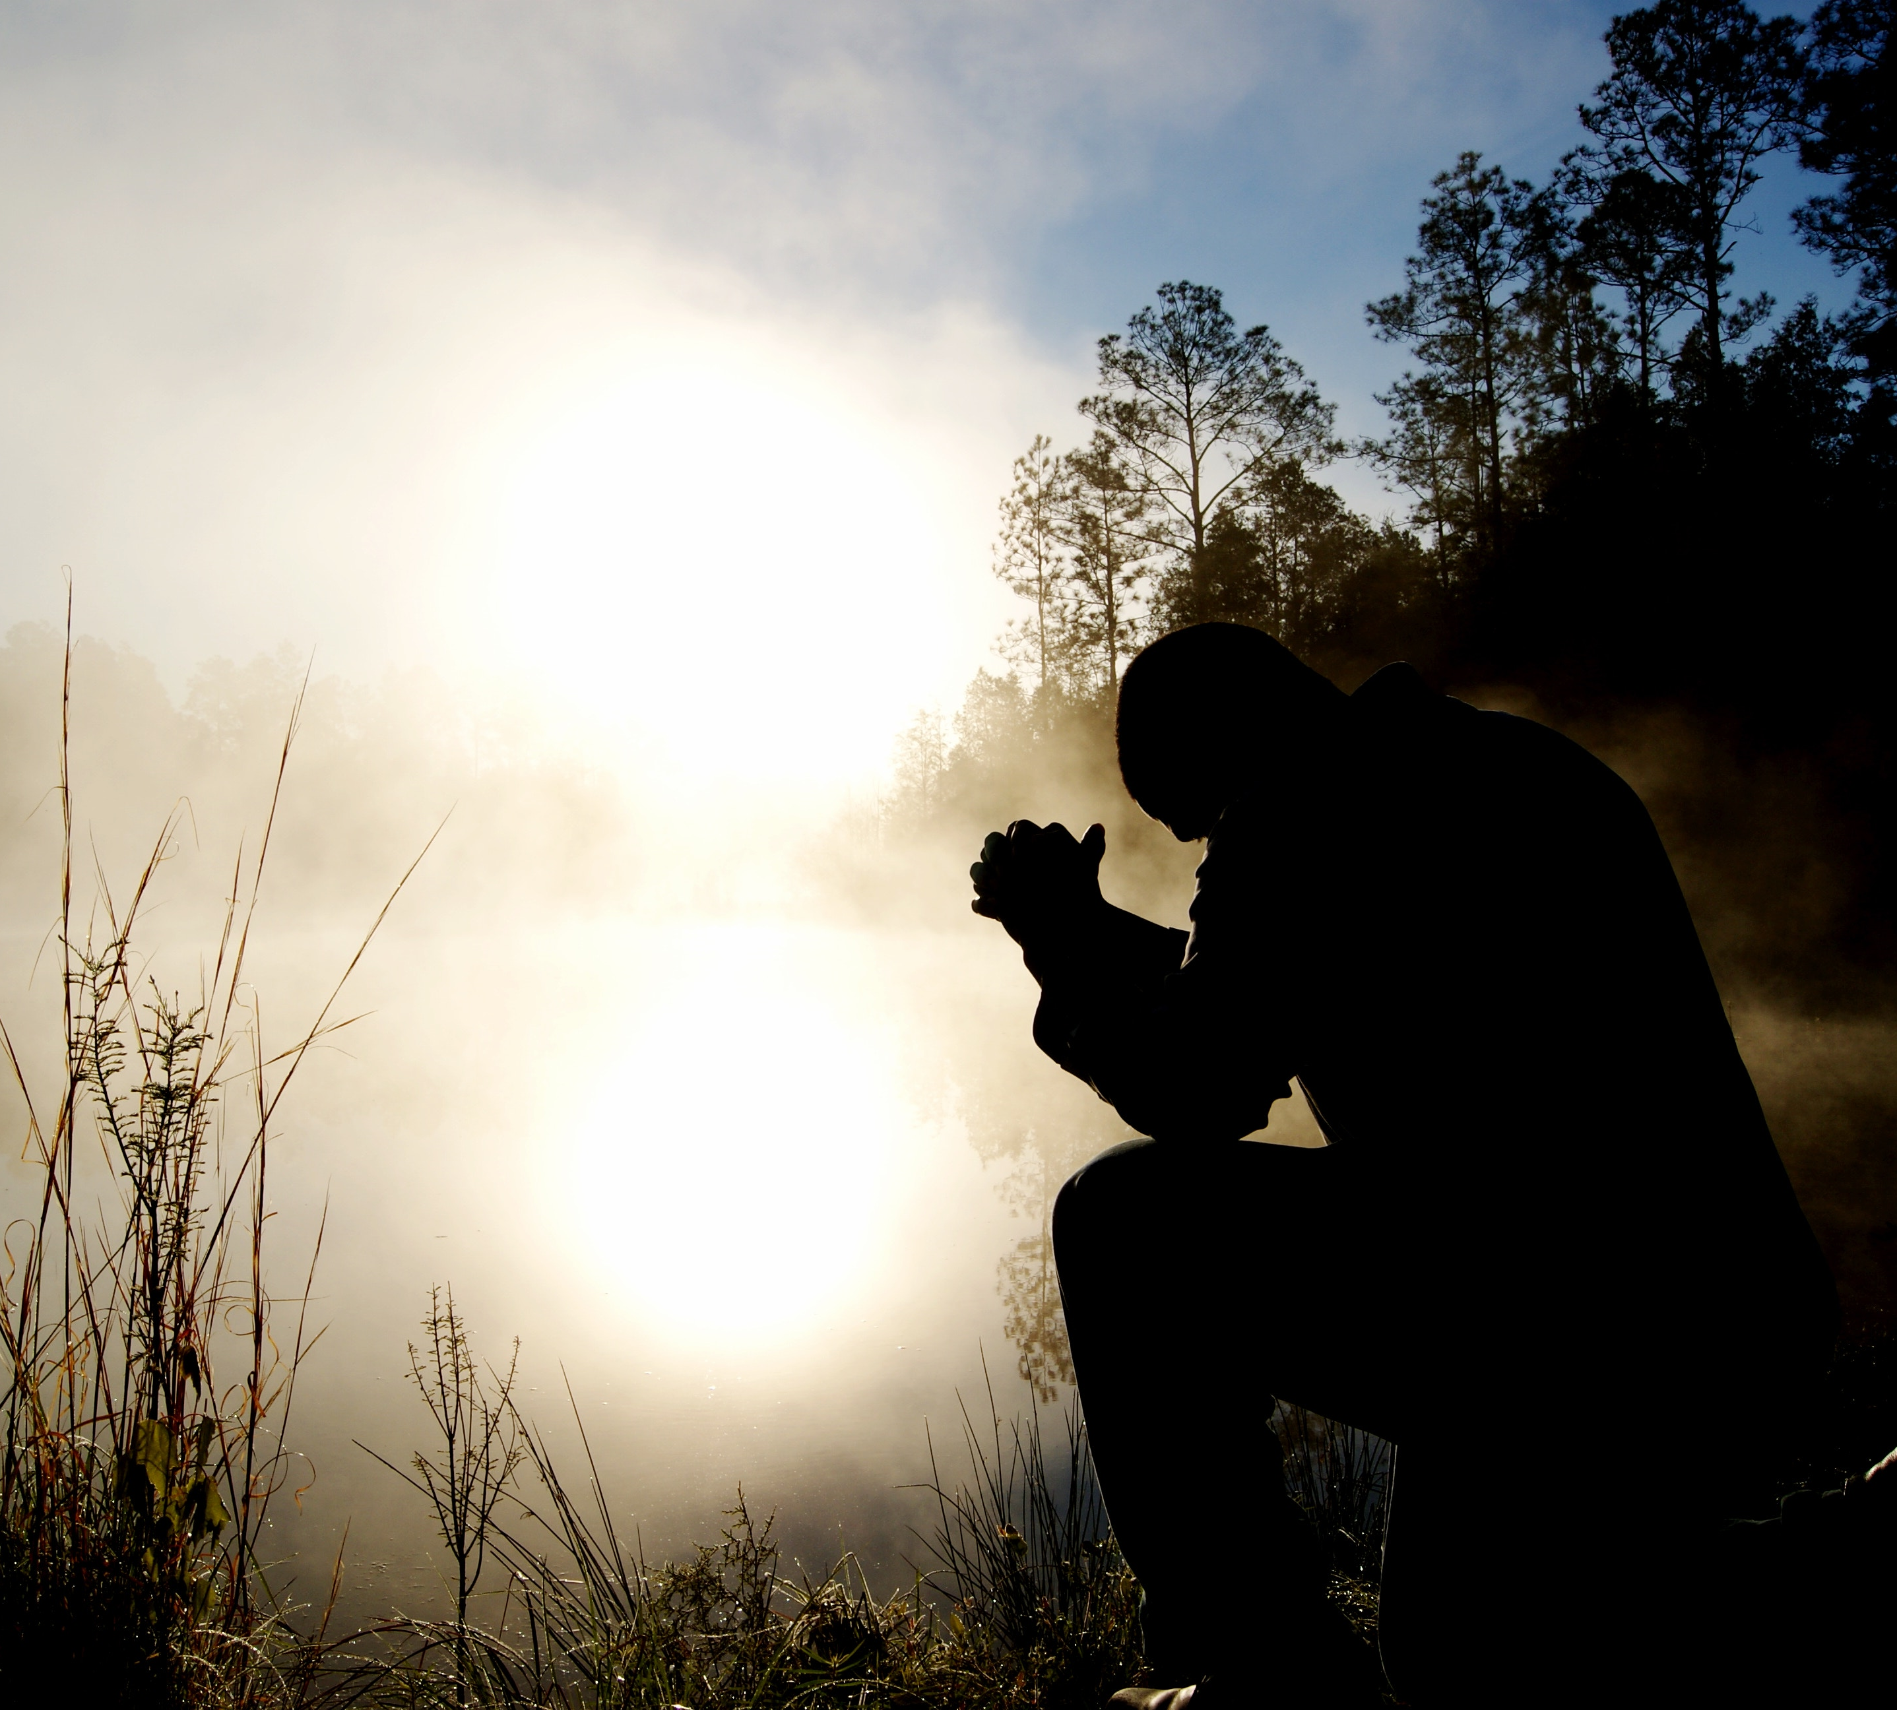
Seek Peace
Search me, O God, and know my heart; test me and know my anxious thoughts.
Point out anything in me that offends you, and lead me along the path of everlasting life.
Psalm 139:23-24

Slide 2
https://www.gotquestions.org/women-in-ministry.html

Slide 3
How We Communicate Matters
Perspectives Create Expectations
Expectations Create Standards
Standards Create a Response
(Verbal or Non-Verbal)

Slide 4
We are Human!
Spirit
Soul
Body

Slide 5
We Have a Problem
Soul
Body
Our Life

Slide 6
How to Walk in the Spirit
Spirit
Truth
Love
Mind
Body
Our Life

Slide 7
Feed the Spirit… Starve the Flesh

Slide 8
The Biggest Challenge…
Disobedience

Slide 9
Do You Find This To Be A Challenge?

Slide 10
Are they the problem or are YOU the problem?

Slide 11
Intimacy with God

Slide 12
Intimacy with God
A measure for your relationship with God can be defined by your love and obedience to Him.

Slide 13
Where Do You Fall on the Intimacy Love Triangle?
GOD
Man
Woman

Slide 14
Do You Find Yourself Disconnected?

Slide 15
We Have Gotten Out of Order

Slide 16
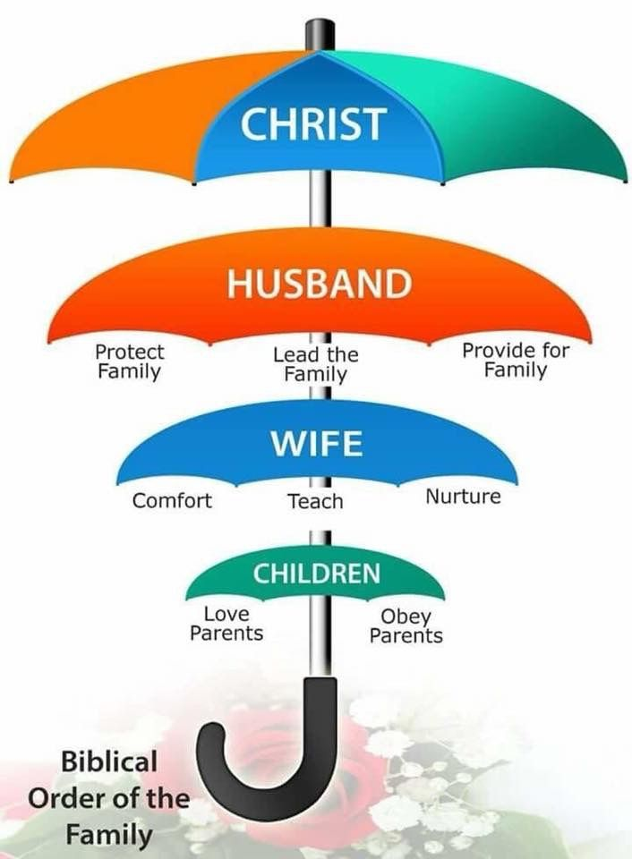

Slide 17
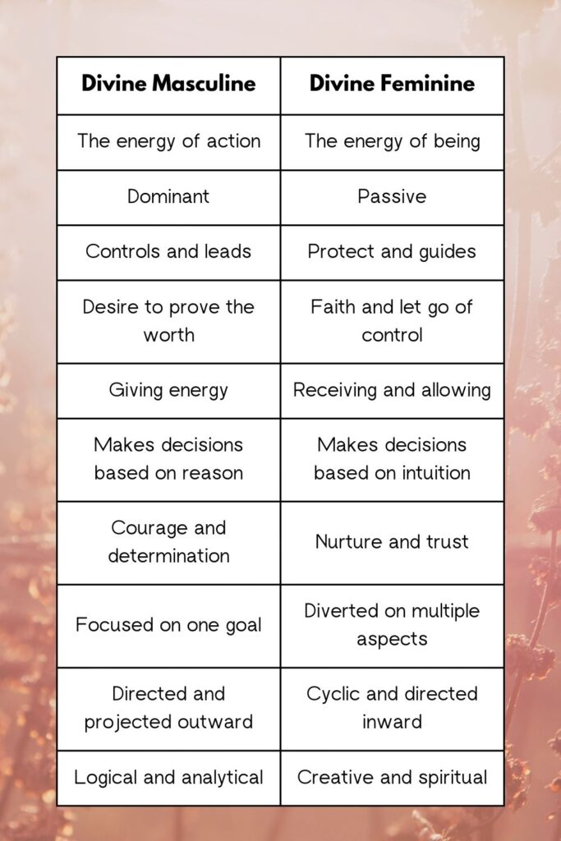

Slide 18
What’s Really Going On?

Slide 19
A Wounded Woman
Victim
Powerless
Weakness
Manipulation
Withholding
Neediness
Co-Dependency
Over Sensitivity
Over Emotional

Slide 20
A Wounded Man
Perpetrator
Abuse of Power
Dominance
Aggression
Control
Competitive
Confrontational
Criticism
Avoidance
Unsupportive
Unstable

Slide 21
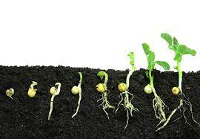
Man is the Seed

Slide 22
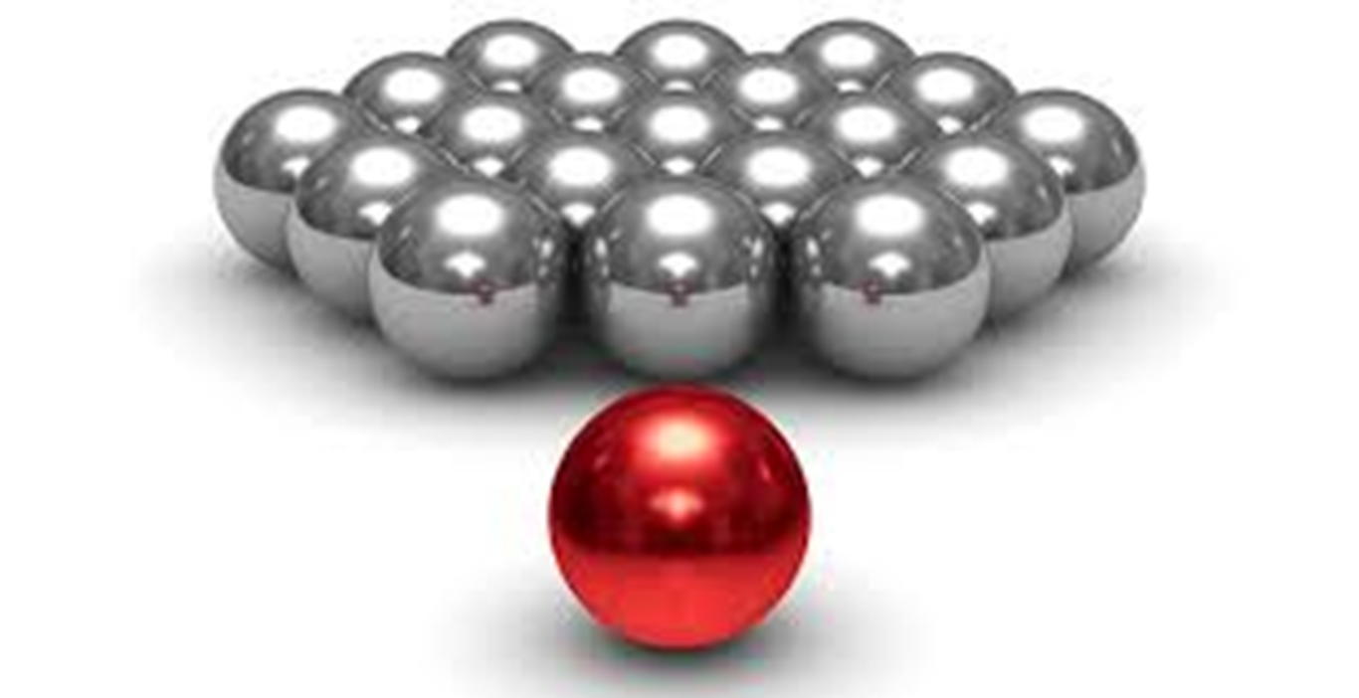
Woman Multiplies

Slide 23
Matthew 7:3-5
3 “Why do you look at the speck of sawdust in your brother’s eye and pay no attention to the plank in your own eye?
4 How can you say to your brother, ‘Let me take the speck out of your eye,’ when all the time there is a plank in your own eye?
5 You hypocrite, first take the plank out of your own eye, and then you will see clearly to remove the speck from your brother’s eye.

Slide 24
From Selfish to Selflessness
Let each of you look not only to his own interests, but also to the interests of others. –Philippians 2:4
For people will be lovers of self, lovers of money, proud, arrogant, abusive, disobedient to their parents, ungrateful, unholy, heartless, unappeasable, slanderous, without self-control, brutal, not loving good, treacherous, reckless, swollen with conceit, lovers of pleasure rather than lovers of God, -2 Timothy 3:2-4
But if anyone has the world's goods and sees his brother in need, yet closes his heart against him, how does God's love abide in him? -1 John 3:17
For where jealousy and selfish ambition exist, there will be disorder and every vile practice. -James 3:16

Slide 25
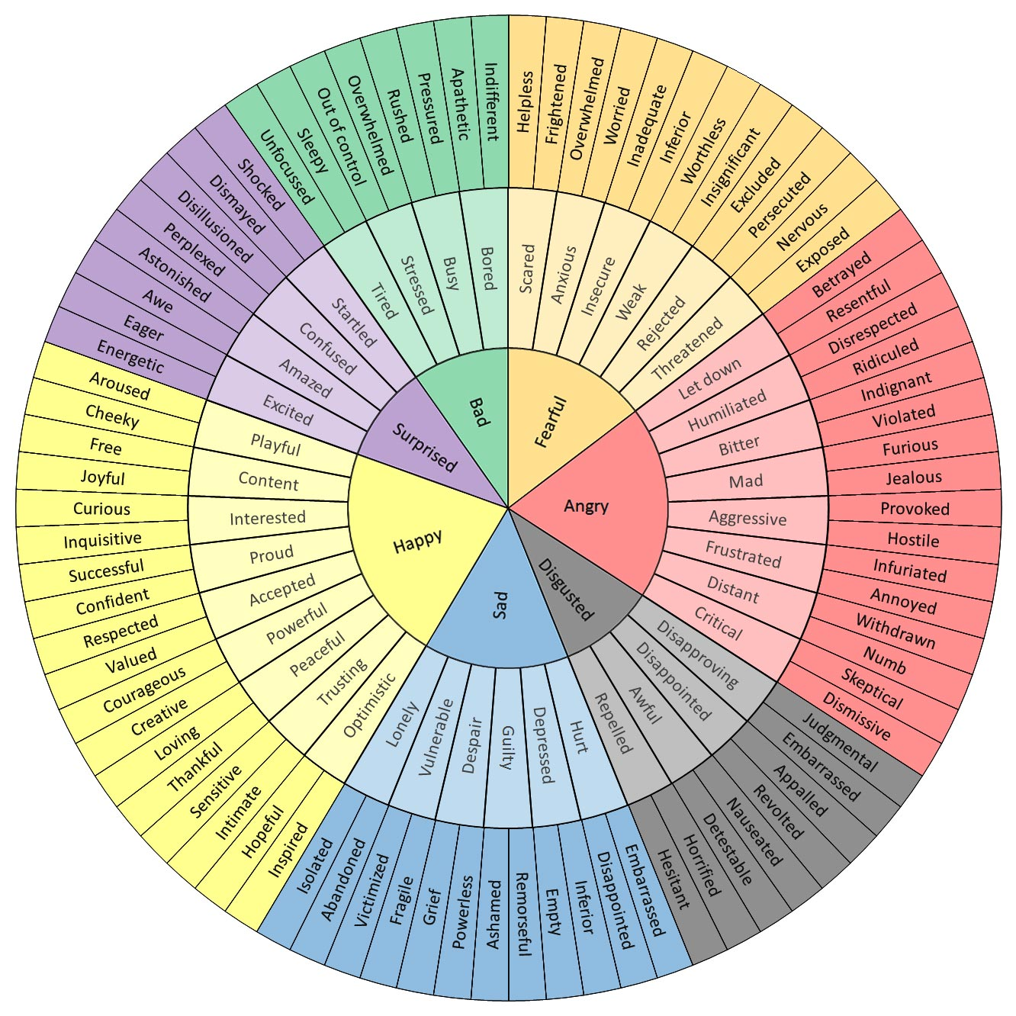
I Am Working Through My…

